Slide 1
Coupling constants
Chapter 4

Slide 2
How to measure the coupling constant?

Slide 3
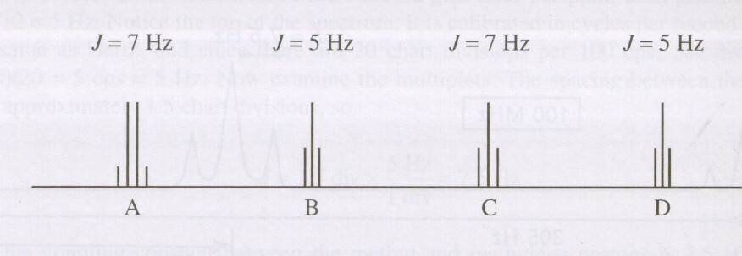
The coupling constants of the groups of protons that split one another must be identical

Slide 4
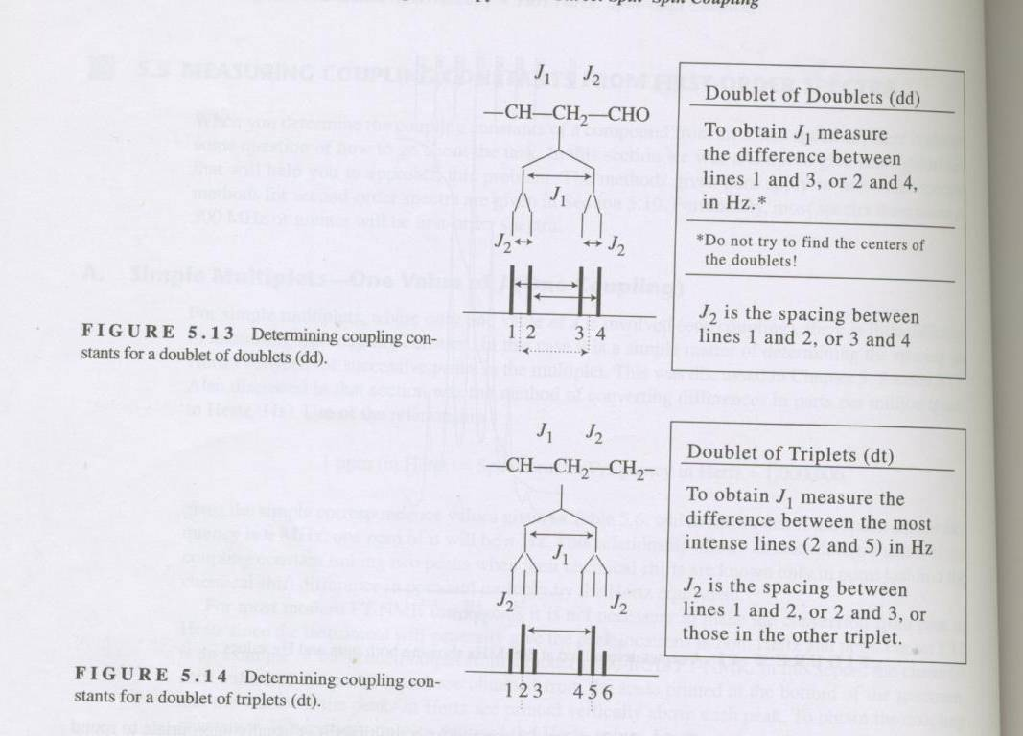
Tree building

Slide 5
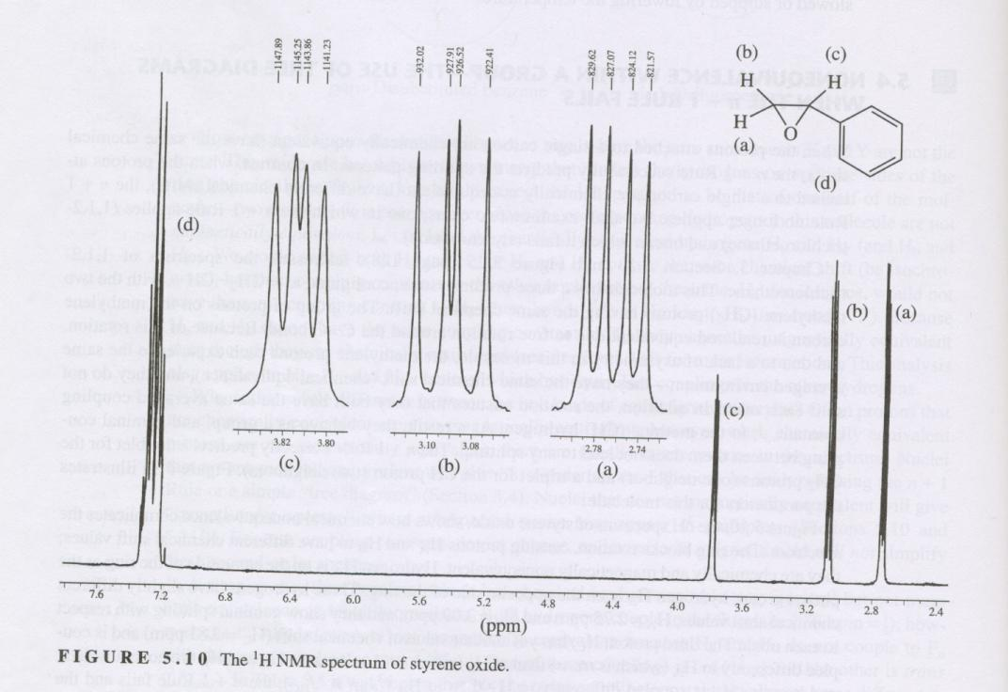
Styrene epoxide

Slide 6
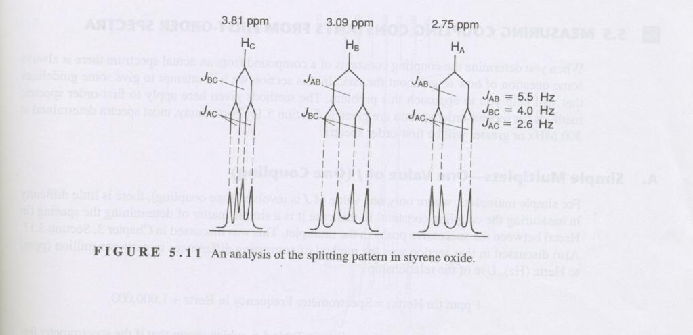
Analysis

Slide 7
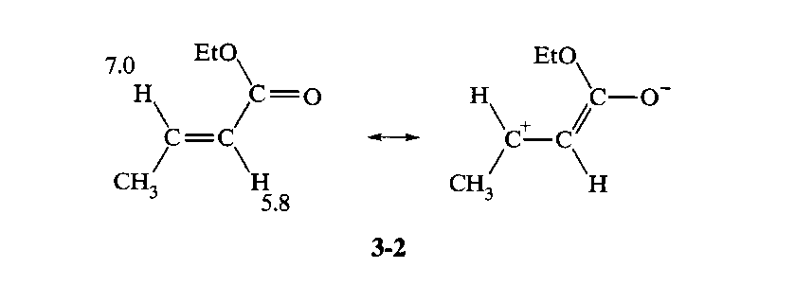
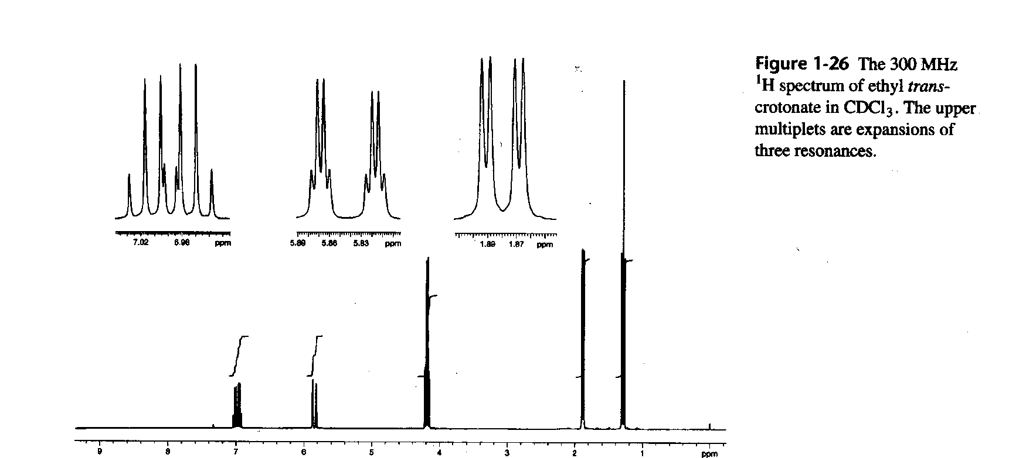
Ethyl trans-crotonate

Slide 8
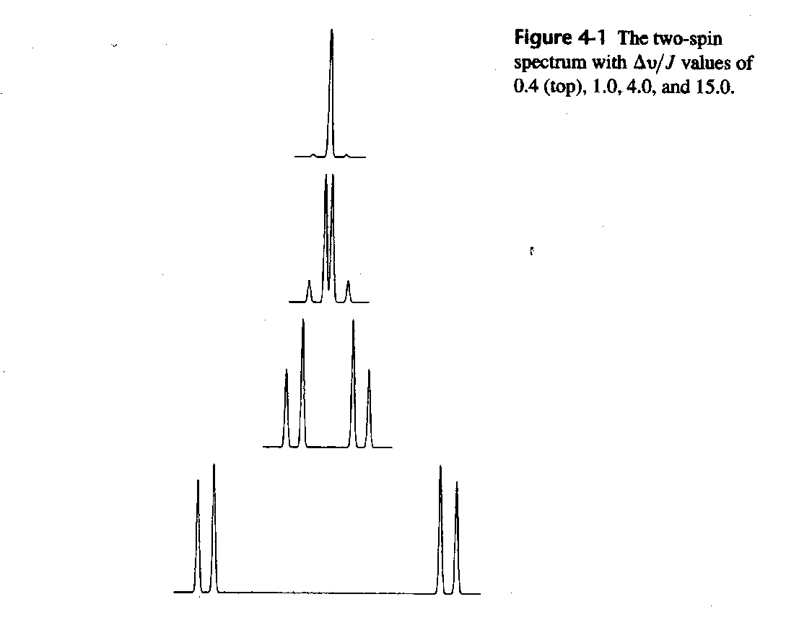
First and second order

Slide 9
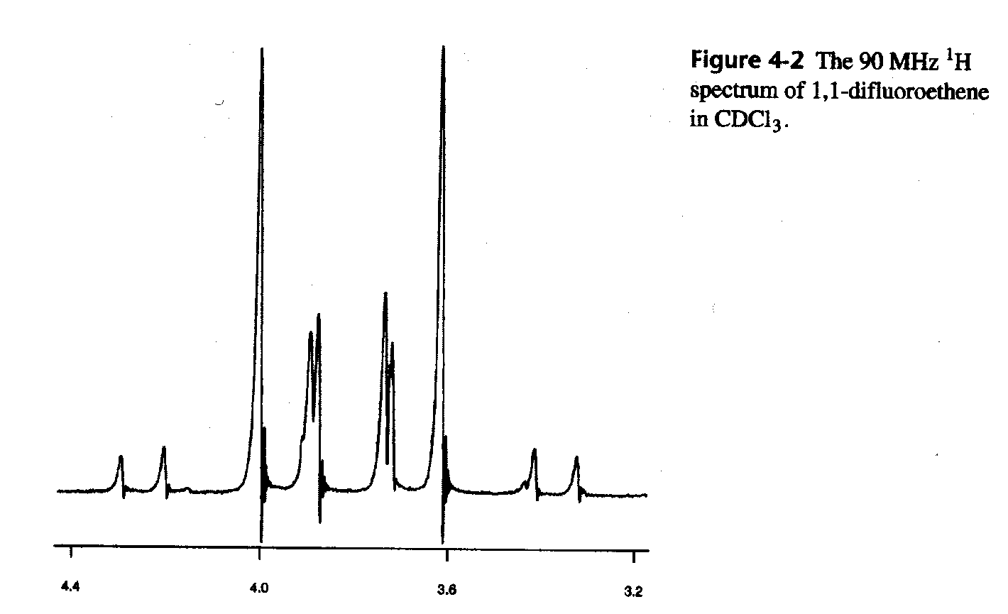
1,2-difluoroethene

Slide 10
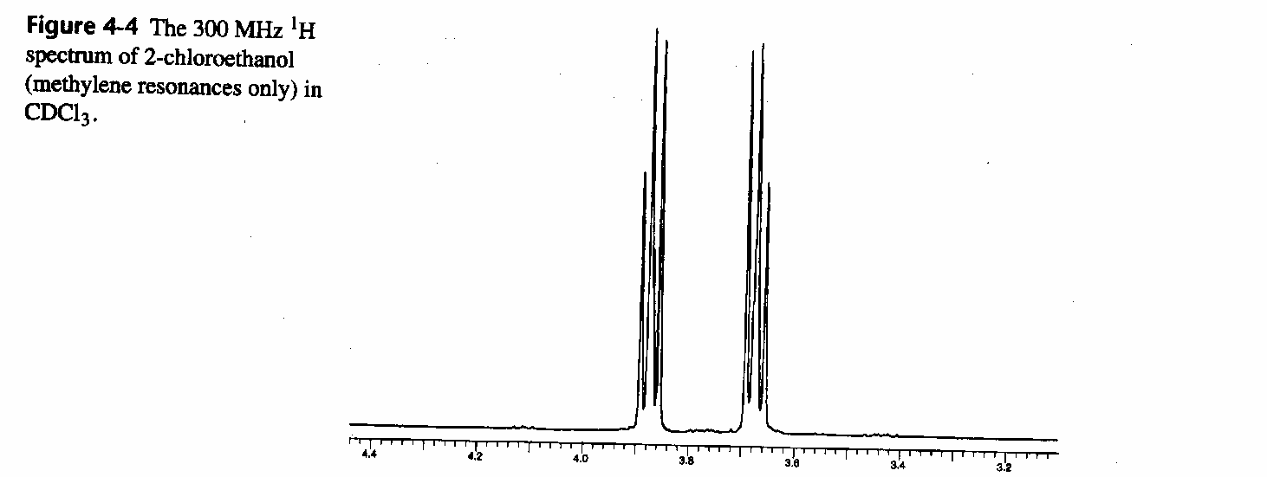
2-chloroethanol

Slide 11
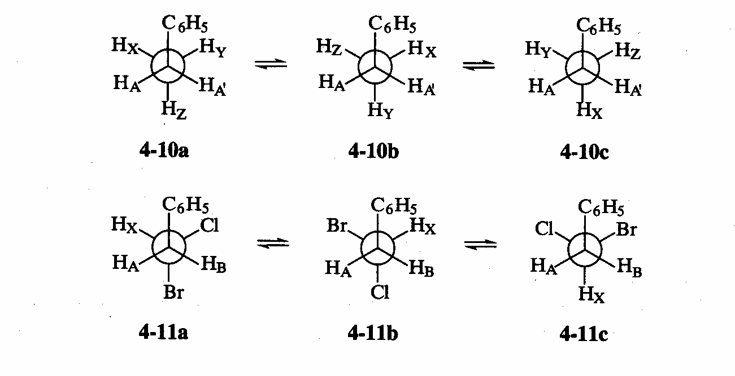
Non-equivalence

Slide 12
Geminal H-H couplings depending on angle

Slide 13
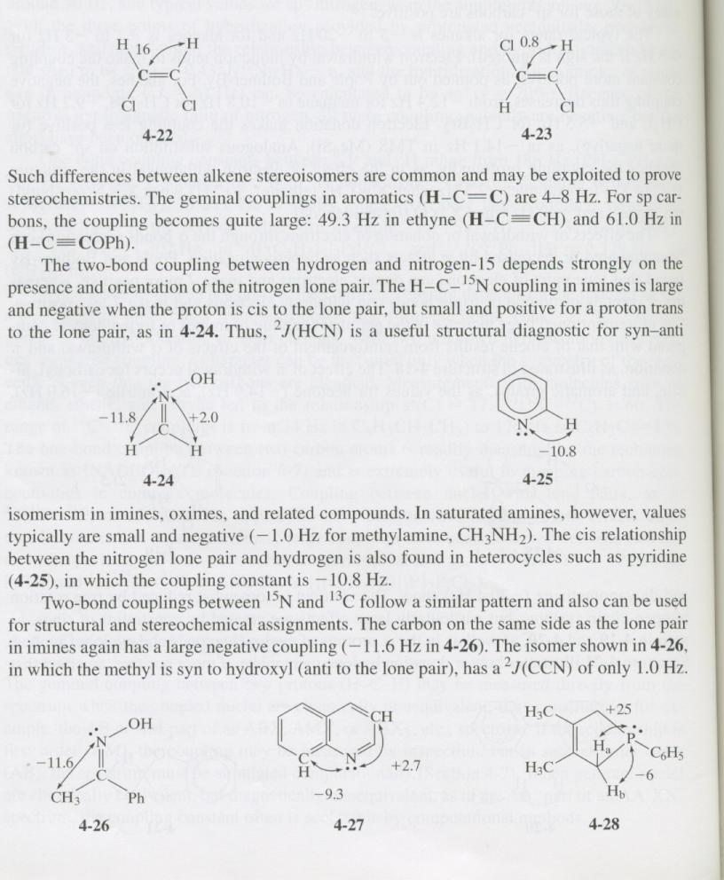
Two-bond

Slide 14
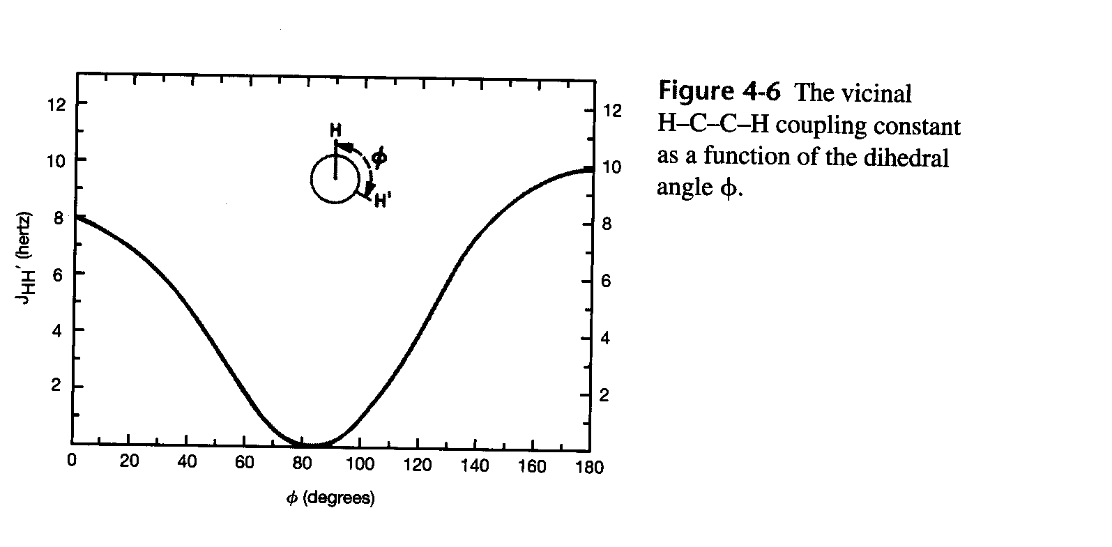
Karplus equation

Slide 15
Three-bond coupling constants of cyclohexanes

Slide 16
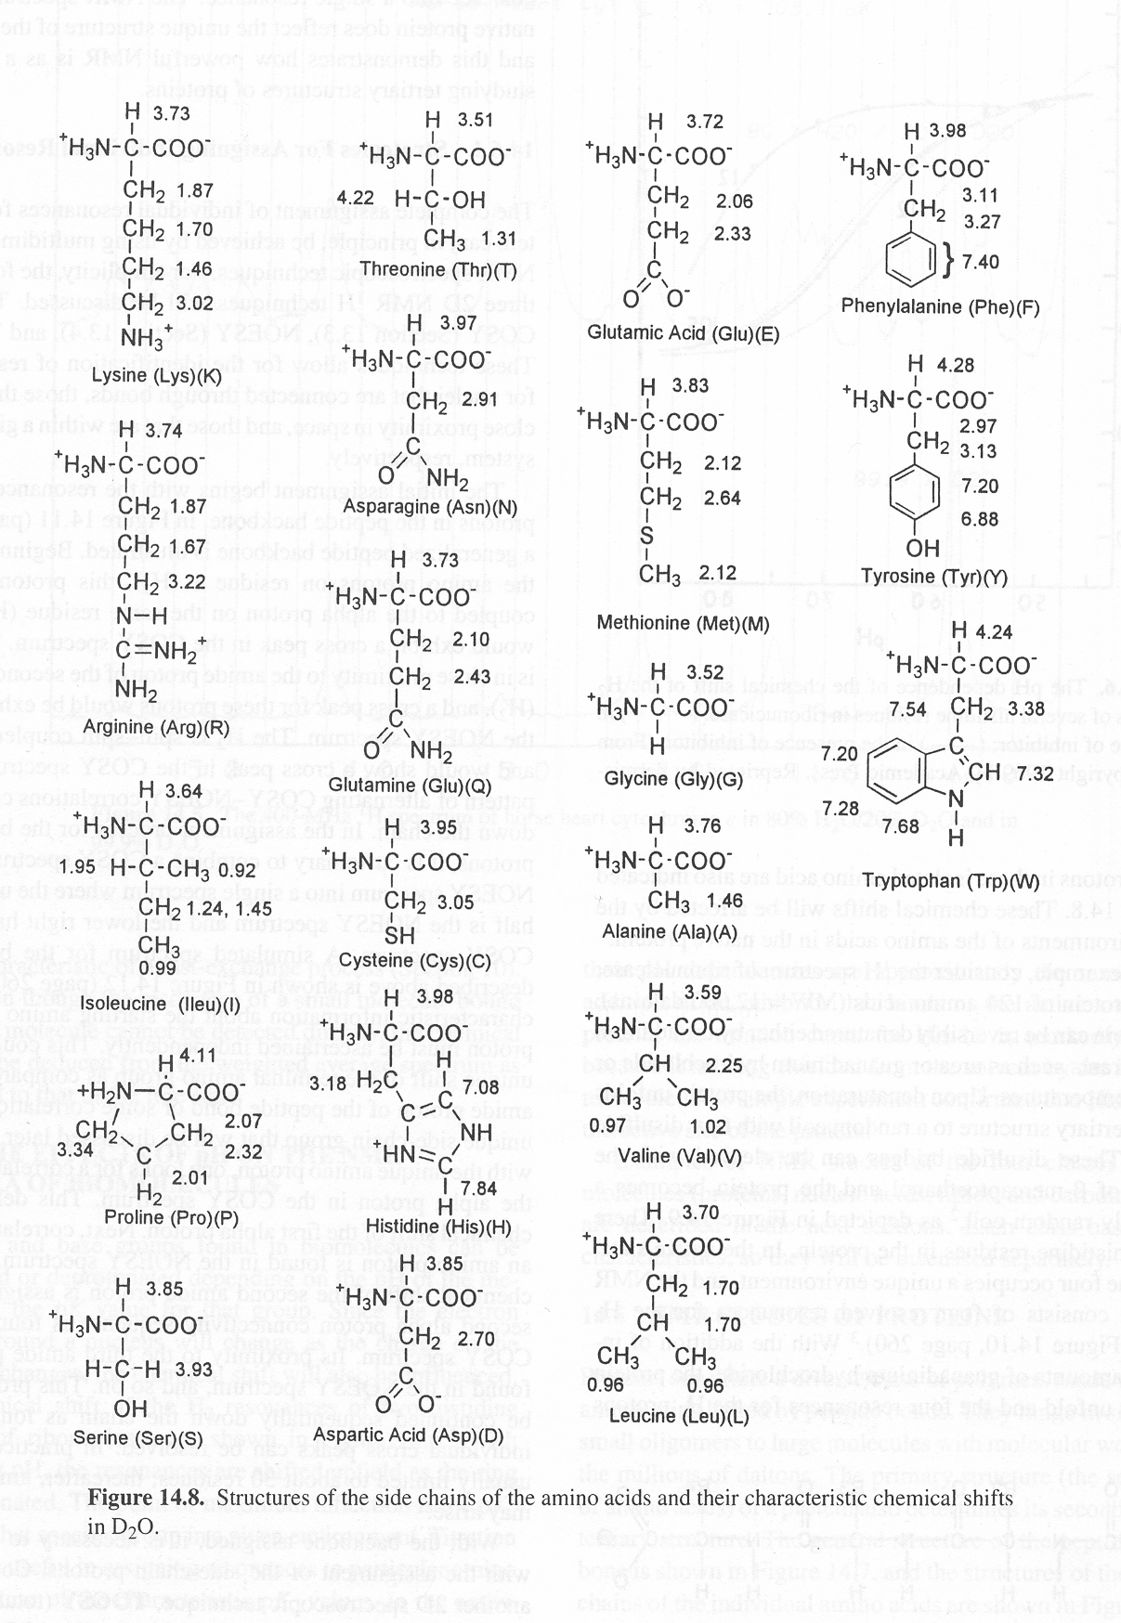

Slide 17
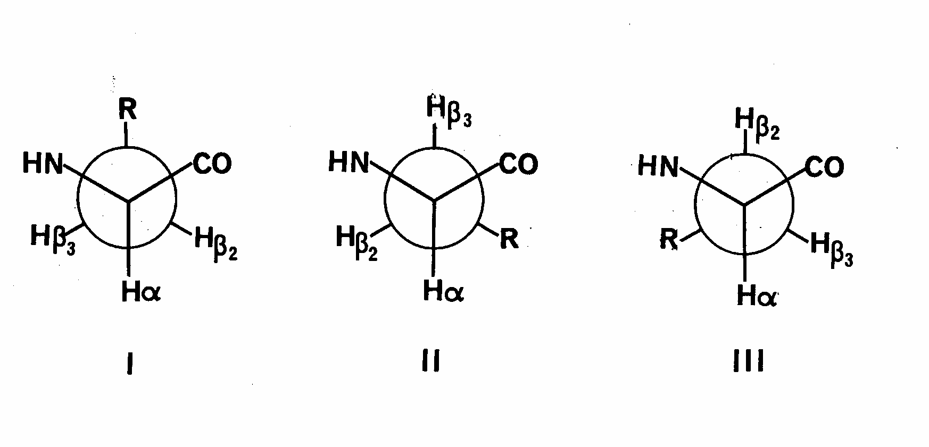
Rotamers of amino acids

Slide 18
Rotamers of amino acids
We can get more inmation if we also measure J(CO,H) and
J(C,C) coupling constants

Slide 19
Coupling constants of double bonded systems

Slide 20
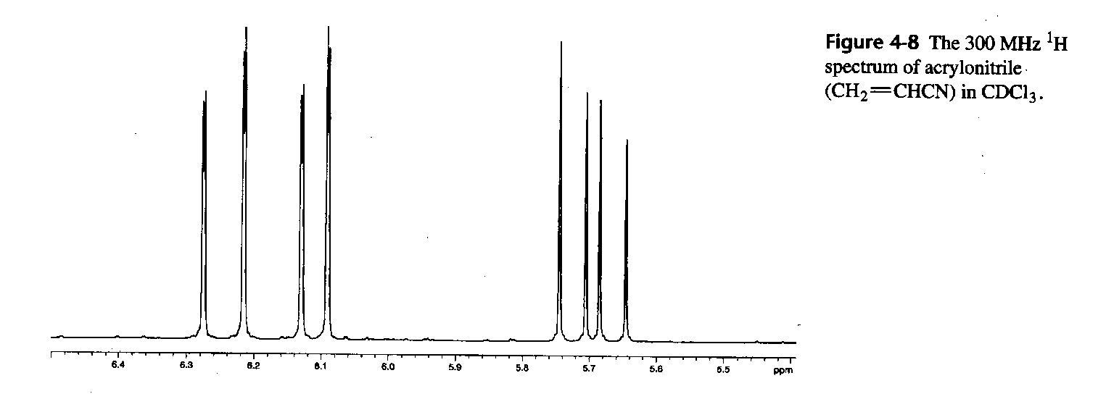
Acrylonitrile
Couplings?

Slide 21
Coupling constants in benzene systems

Slide 22
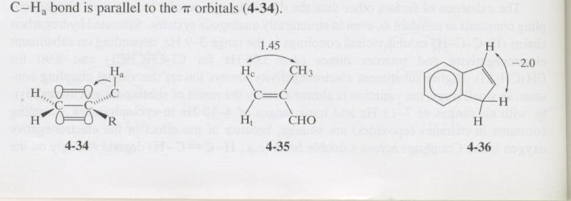
Allyllic

Slide 23
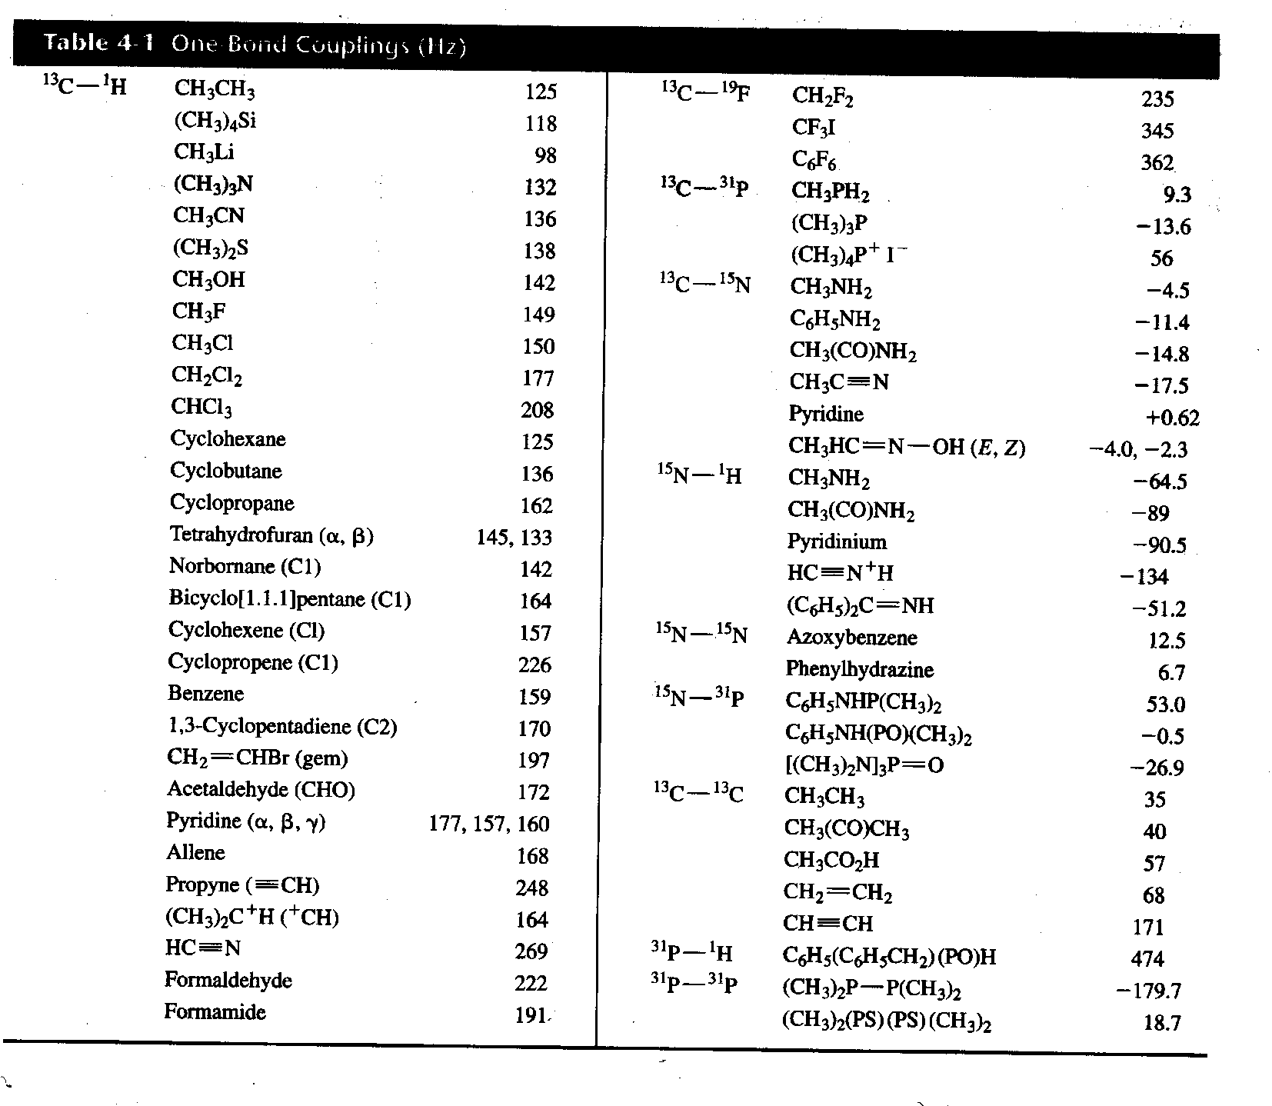

Slide 24
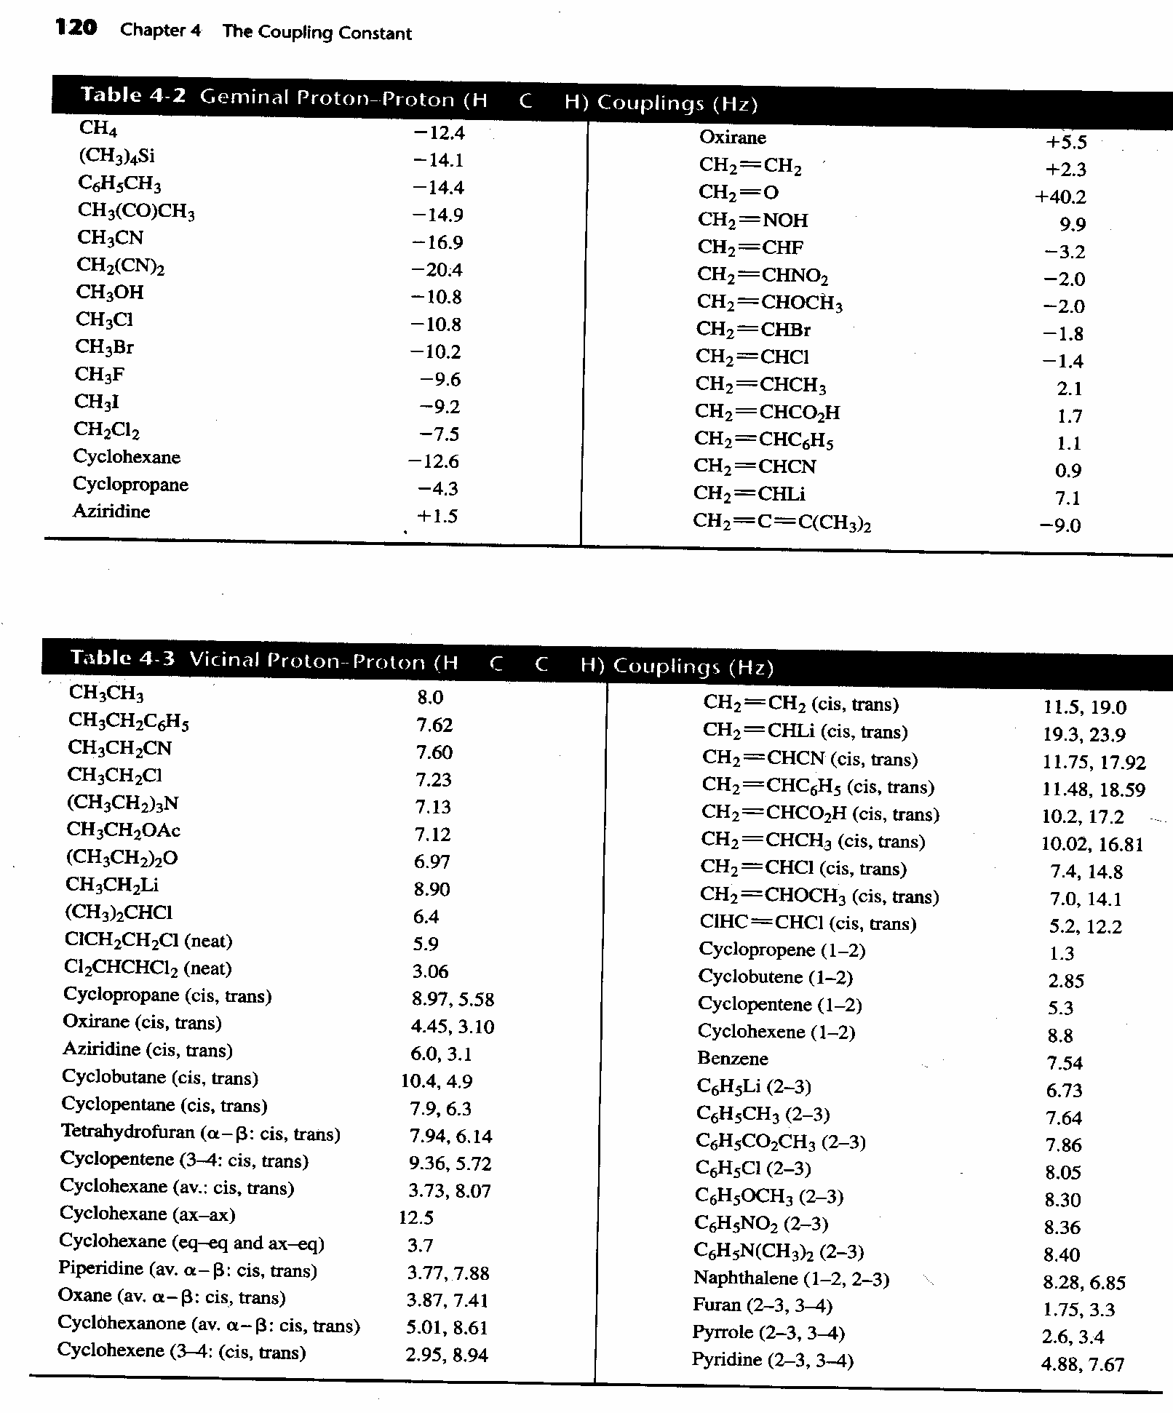

Slide 26
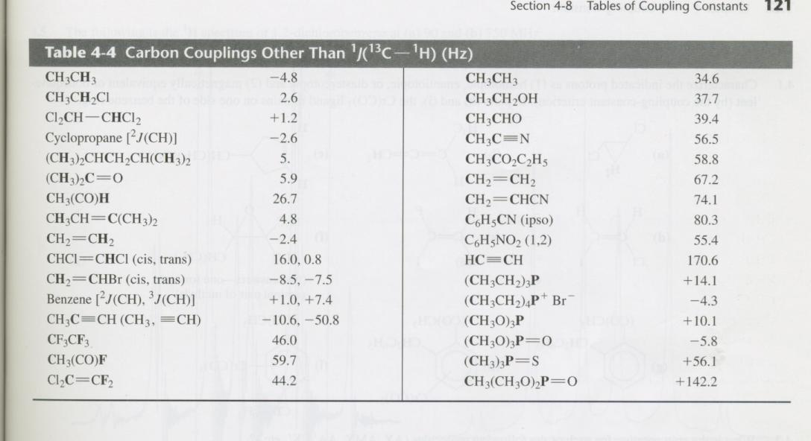
Couplings to carbon

Slide 27
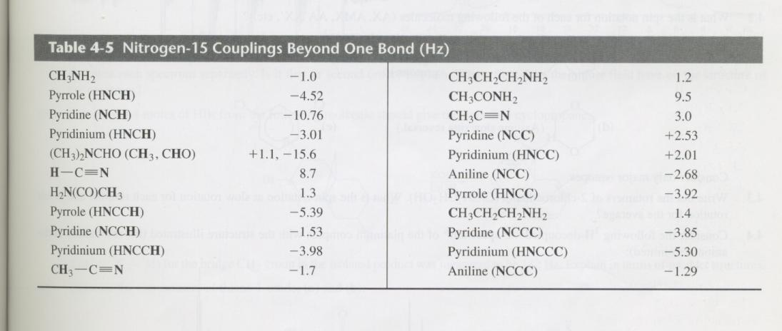
Couplings to 15N

Slide 28
Problems for tomorrow
3.8

